Slide 1

AI Model Project
Exploring AI Innovations and Techniques
Mohammed Althagafi - 443102227
Abdulrahman Mansuor - 443106551

Slide 2

Introduction
This section outlines the objectives and workflow of the AI model project, detailing key steps and methodologies utilized to achieve successful outcomes in model development.

Slide 3

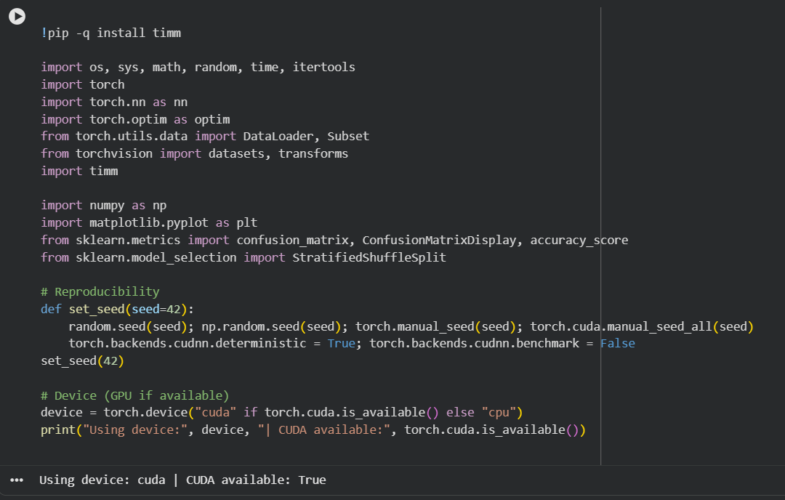
Using the timm Library
Leveraging Pre-trained Models for AI
The timm library simplifies access to a vast array of pre-trained models, enabling efficient model selection and integration for various AI projects, enhancing both development speed and performance.

Slide 4

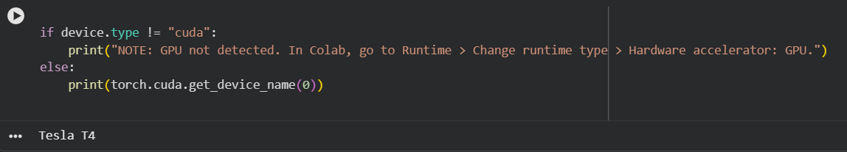
GPU Utilization
Enabling GPU for Enhanced Performance
Utilizing a GPU on Google Colab significantly speeds up training times and enhances model performance, allowing for quicker iterations and results, essential for deep learning projects.

Slide 5
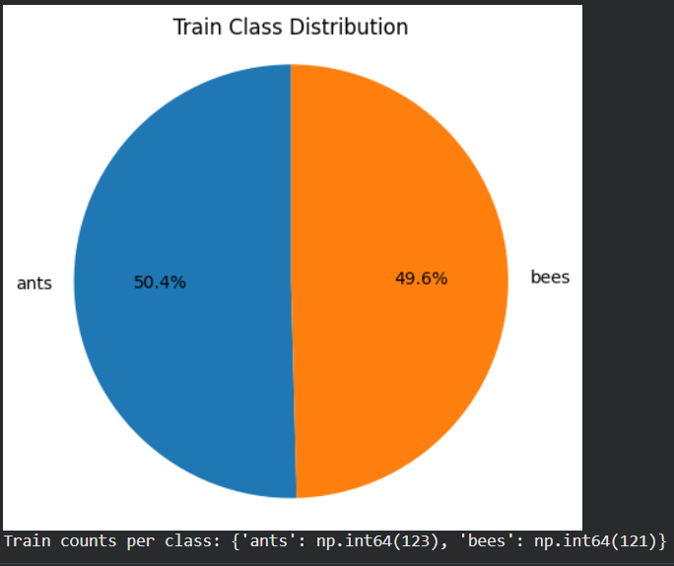
Display Pie Chart
Displaying Statistics in the form of a pie chart
Using matplotlib to display the statistical nature of the dataset.

Slide 6
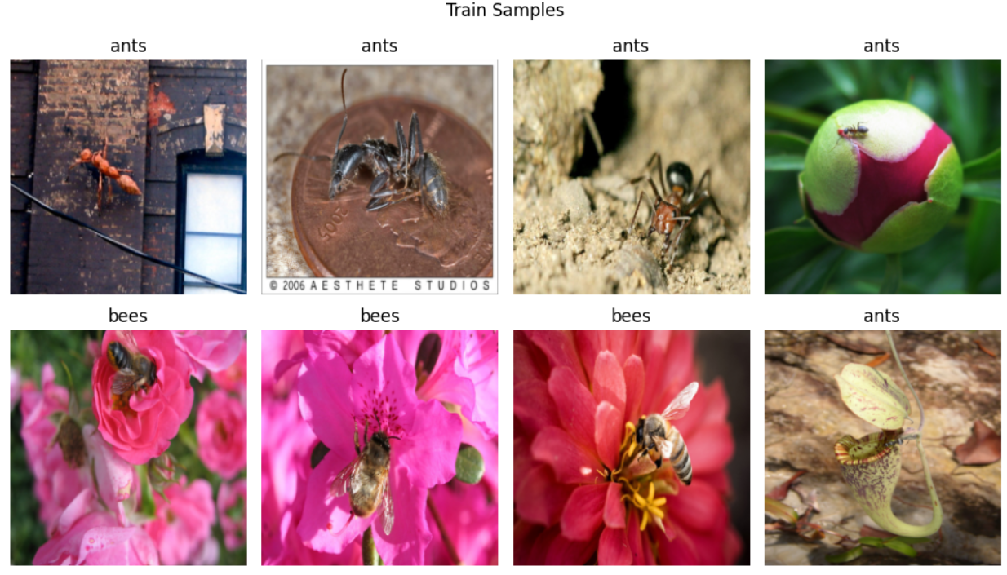
Display Pictures
Displaying some samples from the training set

Slide 7
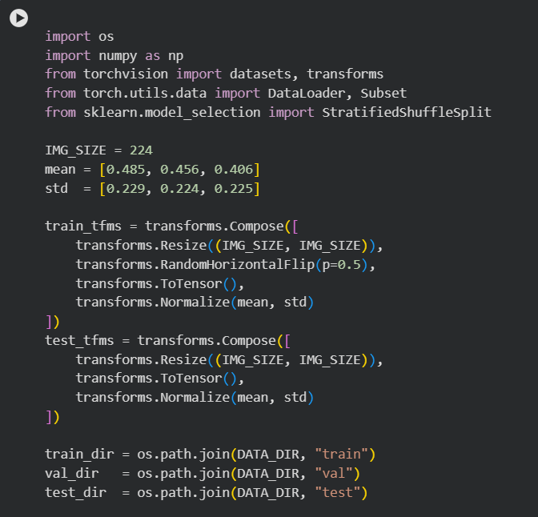

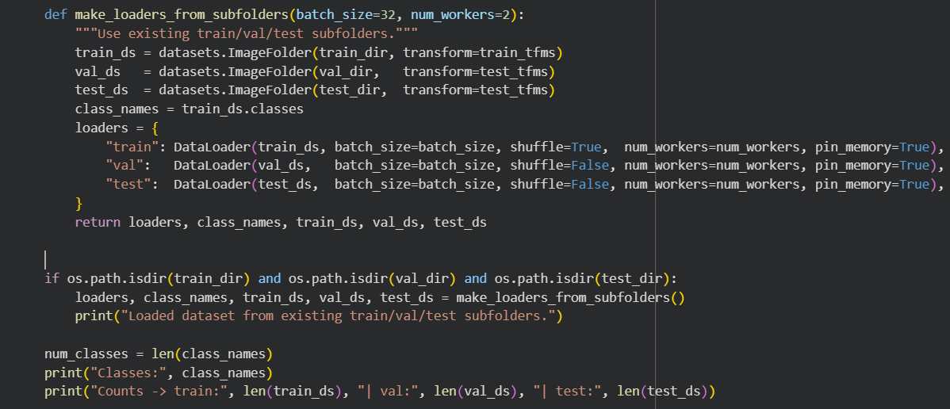
Reading the Dataset
Exploring and Visualizing Data Samples
This section delves into loading the dataset, visualizing sample images, and interpreting key statistics to ensure a comprehensive understanding of the data's structure and content.

Slide 8
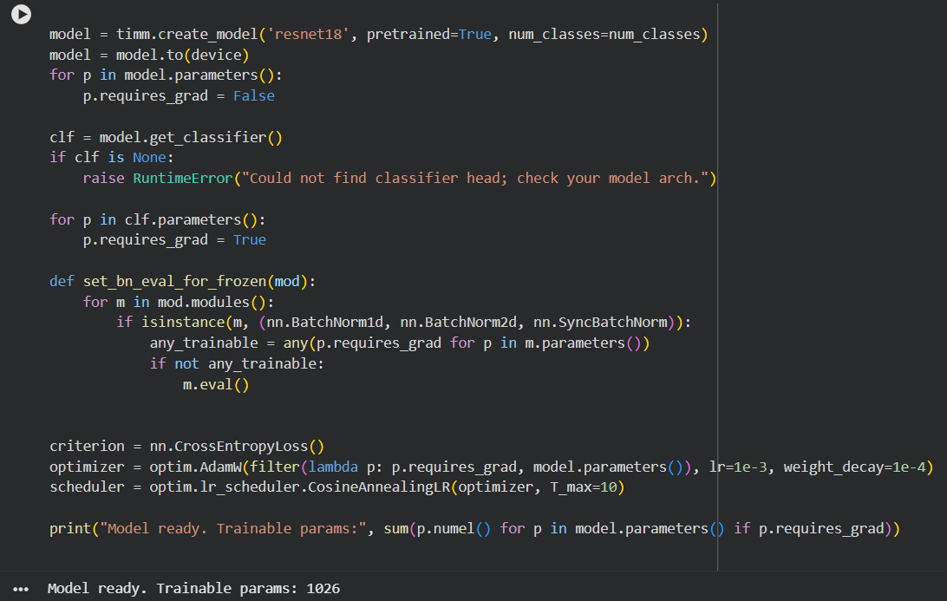
Model Fine-Tuning
Understanding Pre-trained Model Adjustments
Fine-tuning a pre-trained model involves adapting layers to our specific dataset, leveraging transfer learning for improved performance while reducing training time. This approach enhances accuracy and efficiency in model training.

Slide 9
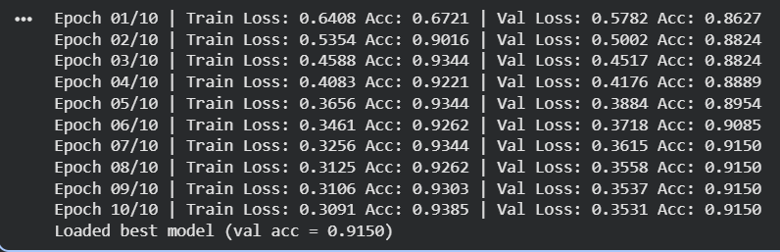
Training the Model
Key Parameters and Training Loop Explained
In this section, we detail the training process of our AI model. Important parameters such as epochs, optimizer selection, and loss functions are crucial for effective learning and performance evaluation.

Slide 10
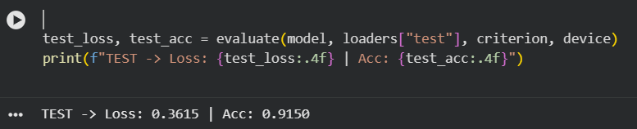
Testing the Model
Evaluating AI performance and accuracy
The testing phase is crucial for assessing the AI model's performance. It involves running the model on unseen data to evaluate its accuracy and effectiveness in making predictions.

Slide 11
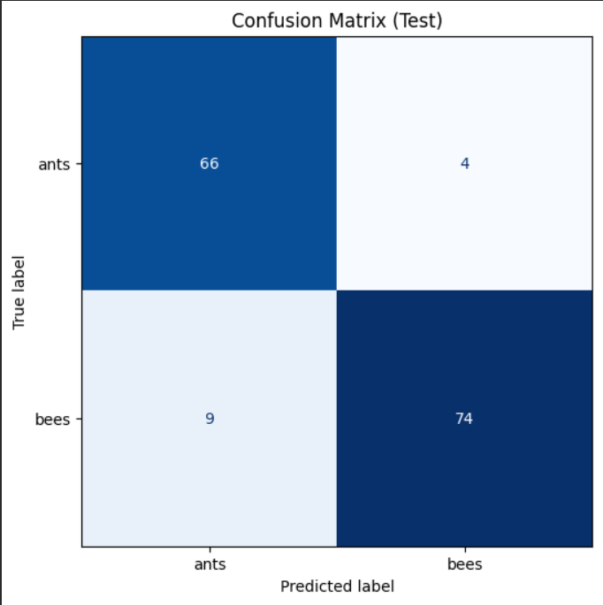
Confusion Matrix
Understanding AI Model Performance Metrics
The confusion matrix provides insightful analysis of the model's classifications, helping to identify strengths and weaknesses. It visually represents true positives, false positives, and other performance indicators crucial for improvements.

Slide 12
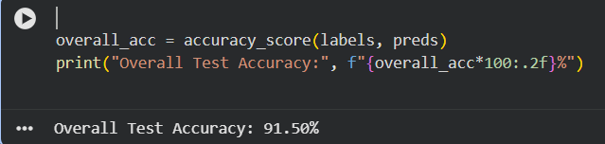
Overall Accuracy
Understanding model performance through accuracy metrics
Computing overall accuracy is crucial for assessing the model's effectiveness. It helps gauge how well the AI is performing and identifies areas for further improvement.

Slide 13
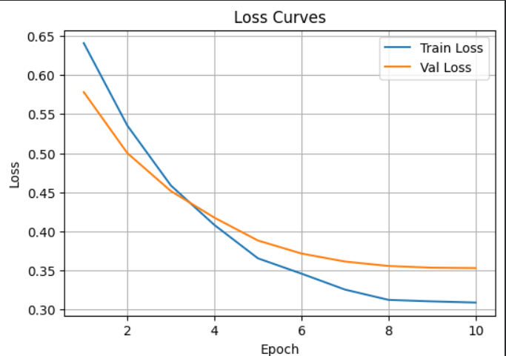
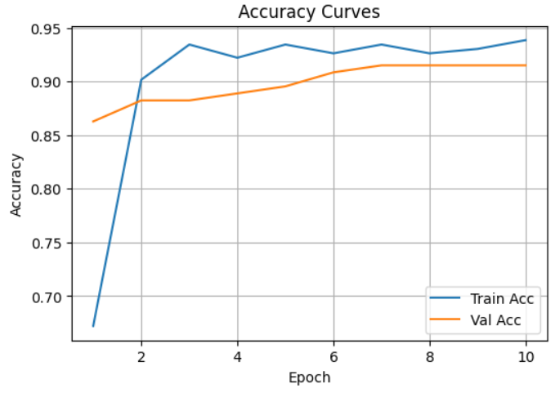
Displaying the Loss
Understanding Loss Curves in AI Models
Analyzing training and validation loss curves is crucial for assessing model performance, revealing insights about overfitting and the generalization ability of the AI model over time.

Slide 14

Conclusion
Any Questions?

